Slide 1
Workforce Salary Analysis & Insights
SQL-Based Data Analysis Project

Slide 2
Introduction
This project analyzes workforce salary data across different roles, experience levels, and locations.
Objective is to extract meaningful insights using SQL queries.
Focus areas:
Salary trends
Remote work adoption
Role-based salary differences
Career growth opportunities
Objectives
Analyze salary distribution across roles and experience levels
Identify high-paying countries and job roles
Study salary growth trends over time
Evaluate remote work adoption
Provide career transition recommendations

Slide 3
Dataset Overview
Methodology
Dataset contains workforce-related information:
Job Title
Experience Level
Salary (USD)
Company Location
Employment Type
Remote Ratio
Work Year
Data imported into MySQL
Data cleaning and structuring
SQL queries used:
Aggregation (AVG, COUNT)
Filtering (WHERE, HAVING)
Joins
CTEs
Window Functions

Slide 4
SQL Queries >

Slide 5
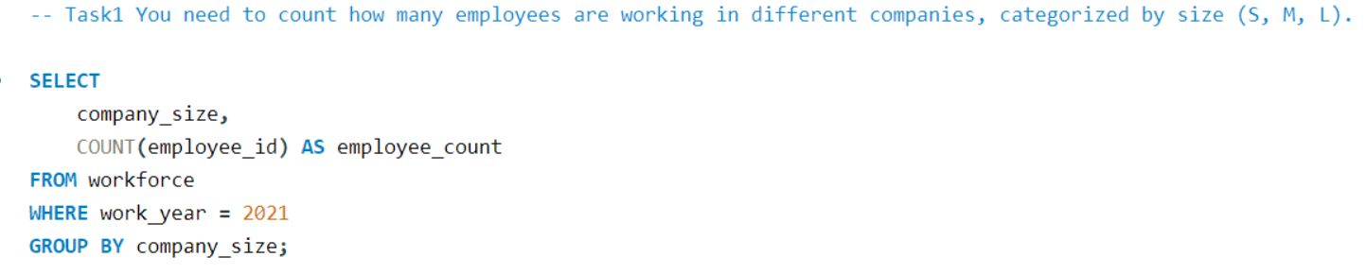
Task1

Slide 6
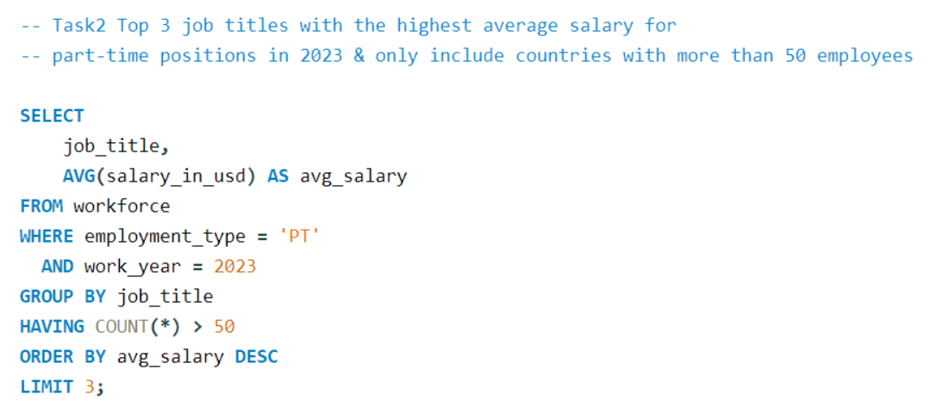
Task2

Slide 7
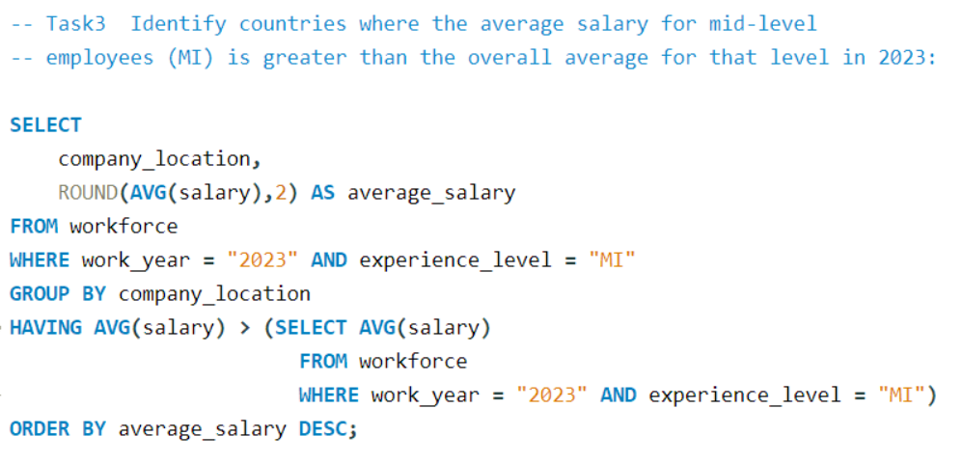
Task3

Slide 8
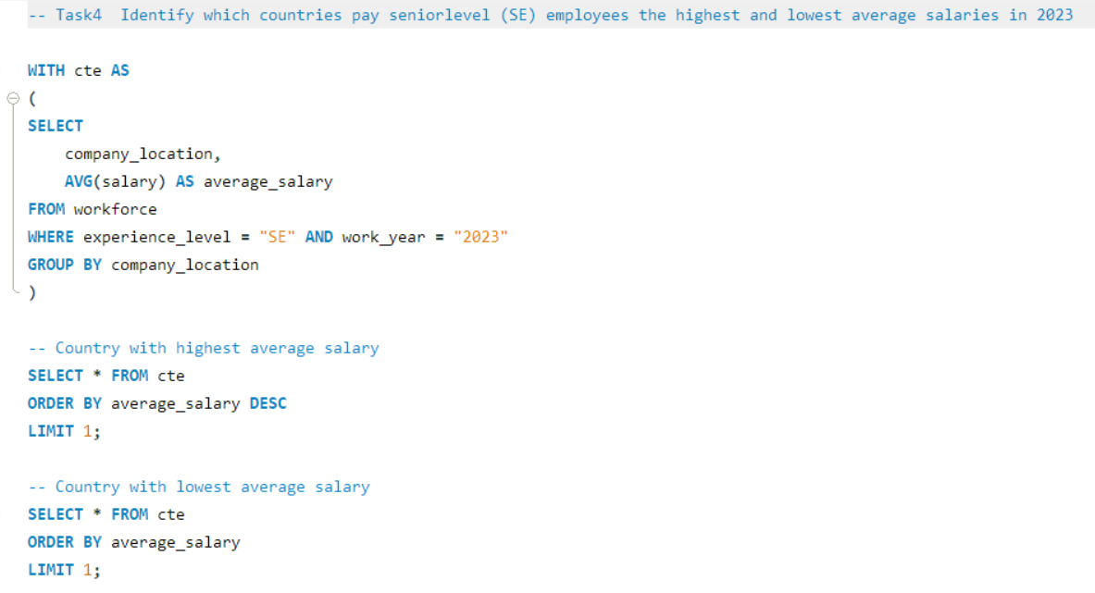
Task4

Slide 9
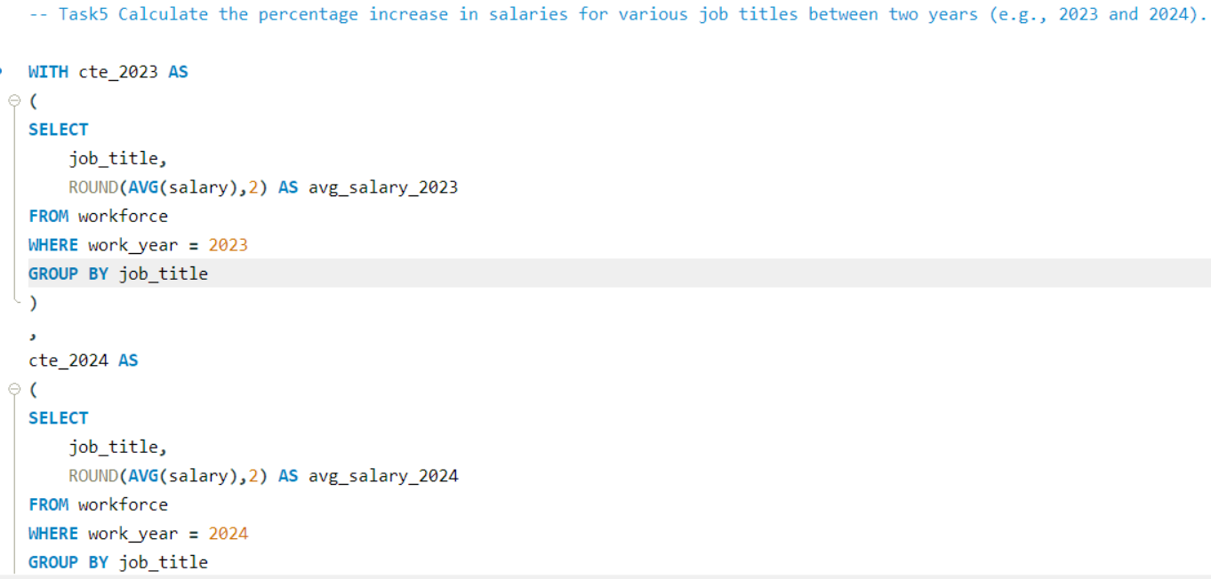
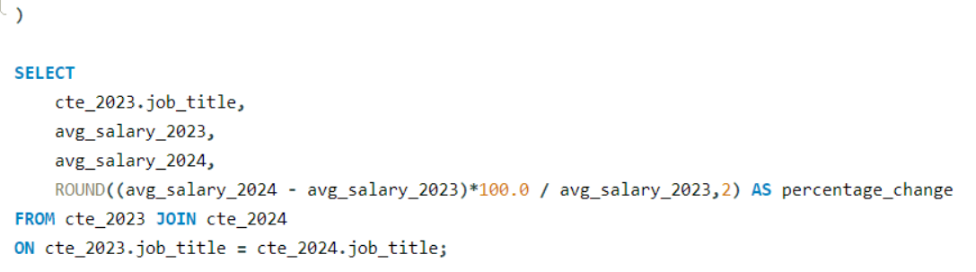
Task5

Slide 10
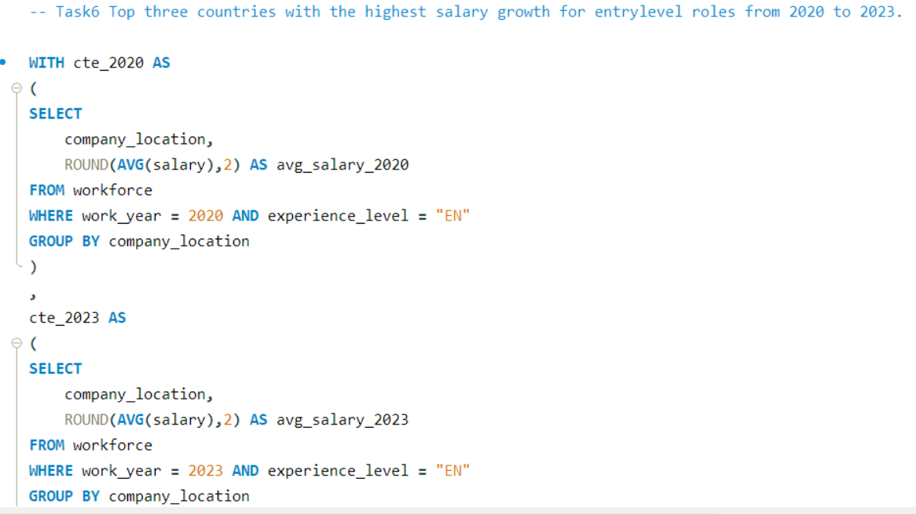
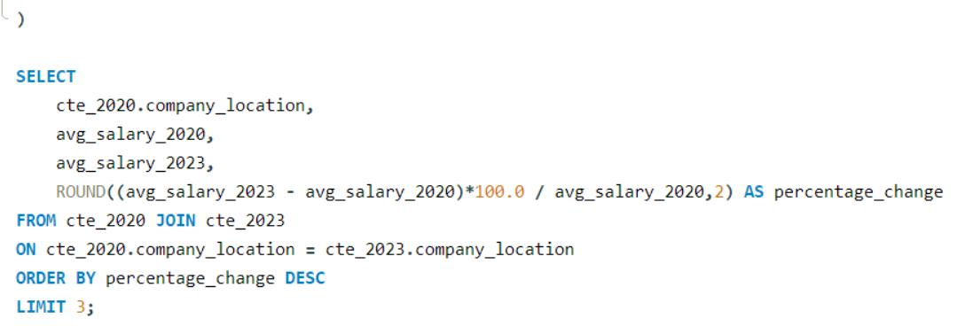
Task6

Slide 11
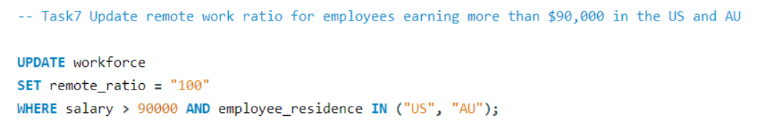
Task7

Slide 12
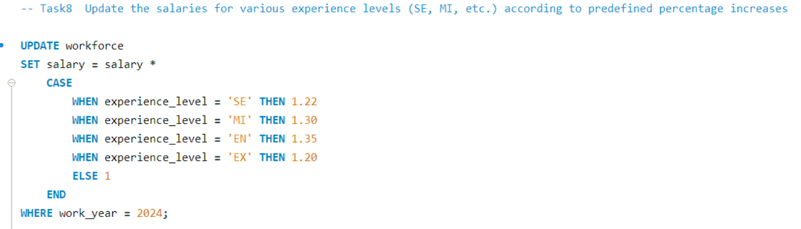
Task8

Slide 13
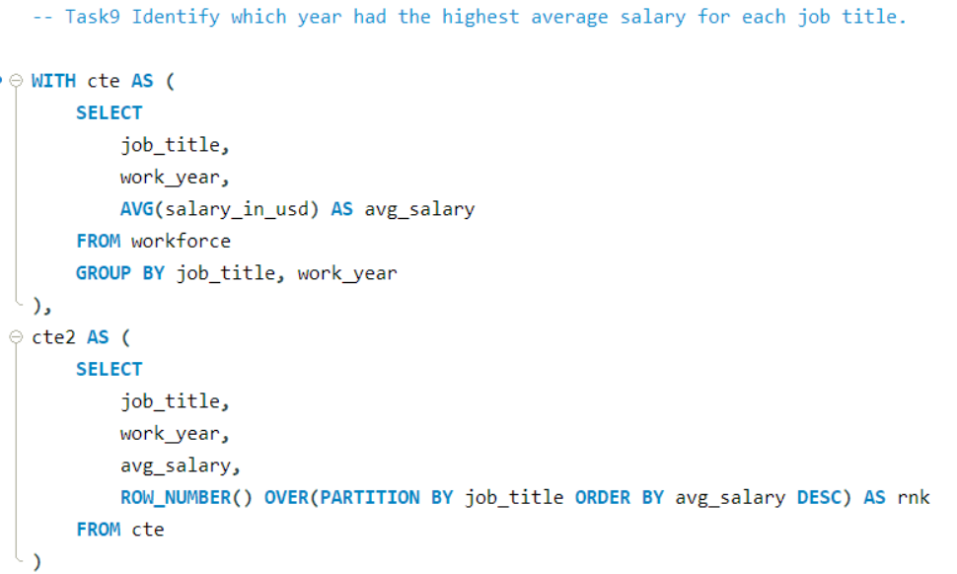
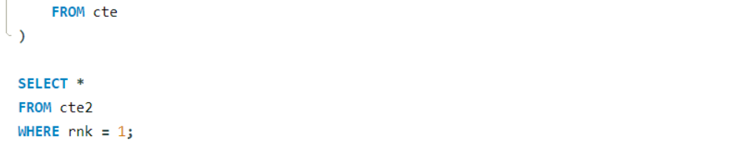
Task9

Slide 14
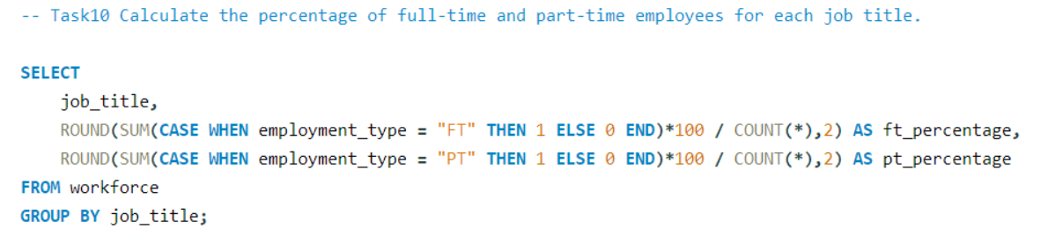
Task10

Slide 15
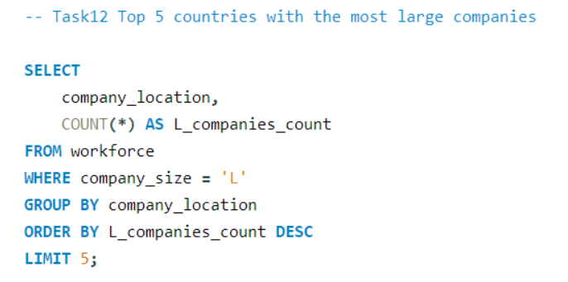
Task12

Slide 16
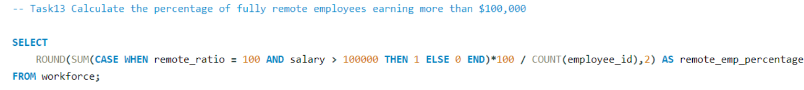
Task13

Slide 17
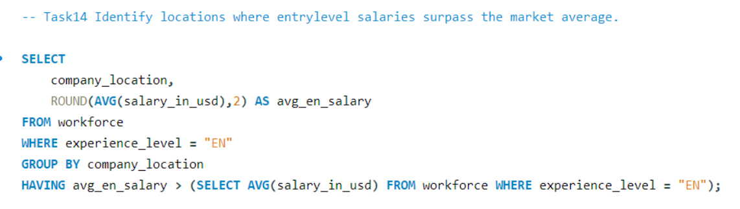
Task14

Slide 18
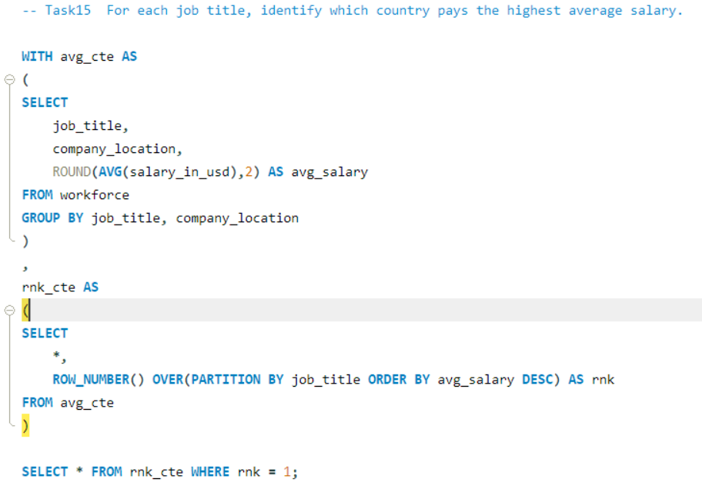
Task15

Slide 19
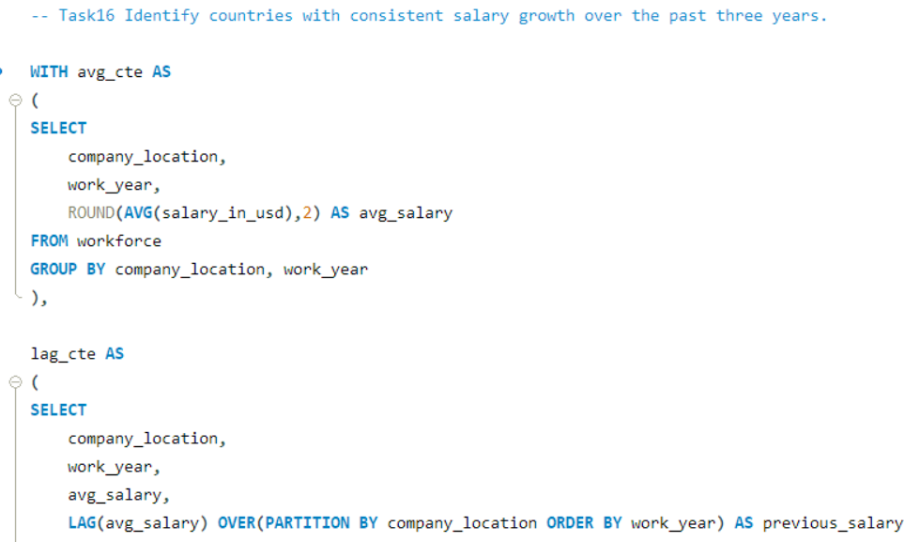
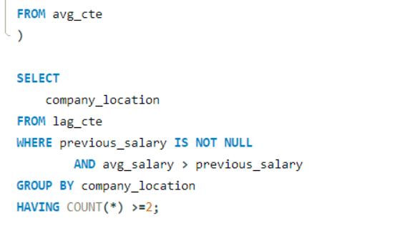
Task16

Slide 20
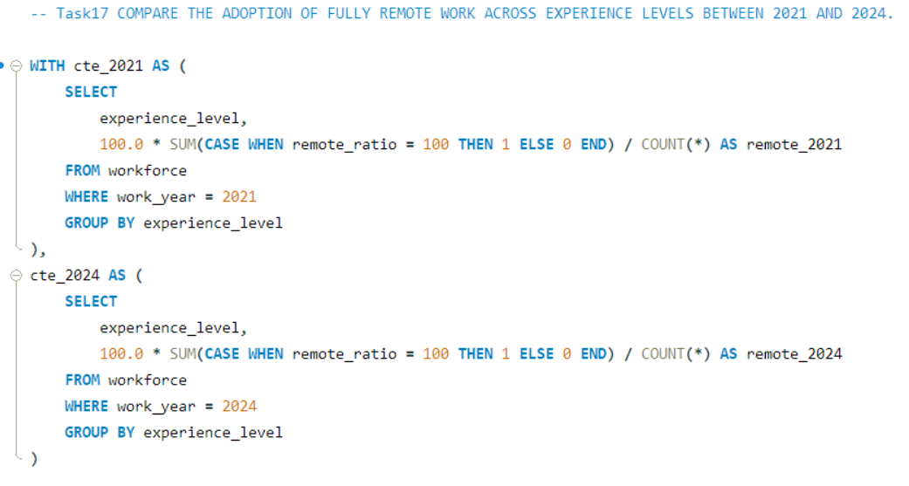
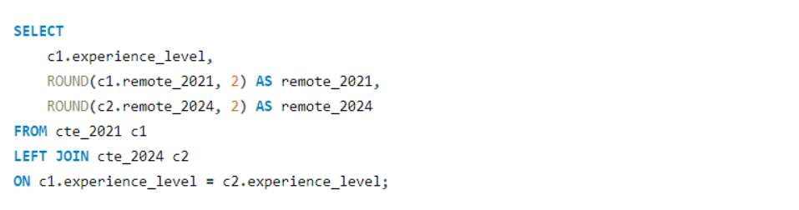
Task17

Slide 21
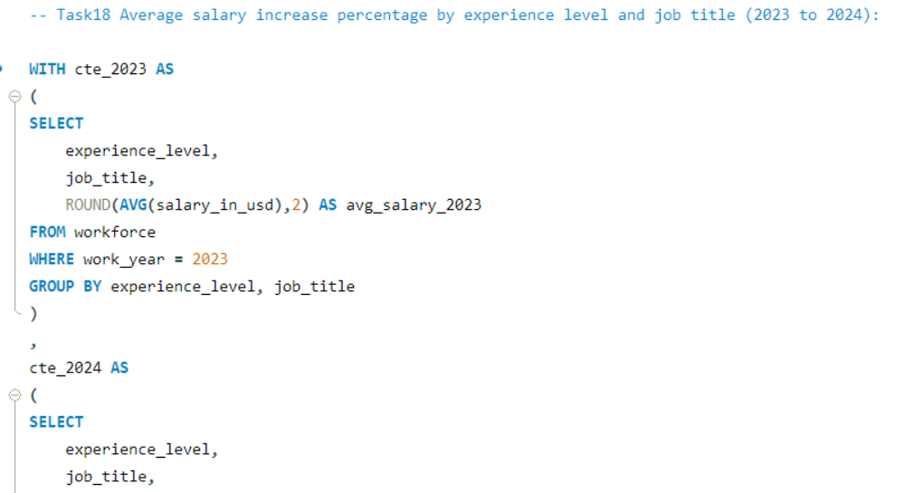
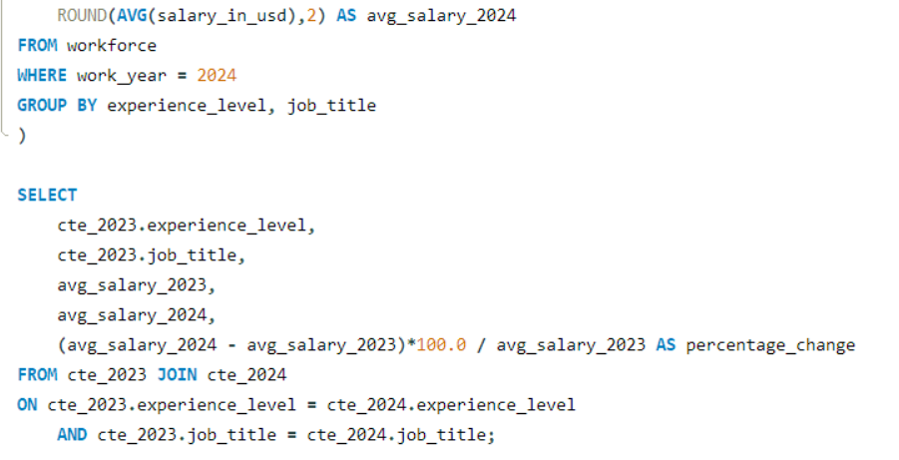
Task18

Slide 22
Key Insights & Conclusions
Salaries increase with experience
Remote work is rapidly growing
AI/ML roles offer highest salaries
Certain countries dominate high compensation
Entry-level roles show strong growth

Slide 23
Thank You.

